Slide 1

Gordo Bot:
Critical Design Review
Team 6:
Zachary Laguna, Raney Ankele, Reid Morse, Cody Nguyen, Thomas Rod, and Nicholas Soliman

Slide 2
Overview
Introduction
Problem Statement
Needs
Objectives and Goals
Requirements and Test Table
Design Constraints
Proposal Design
Updates to Design
System Description
Complete Mod Spec
Project Management
Update Schedule
Update Division of Labor
Preliminary Results
Testing and Validation Procedures
Q/A
Notes:
Jake

Slide 3
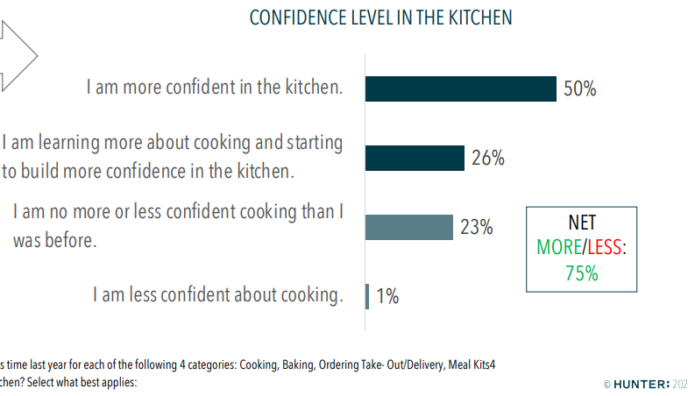
Introduction: Problem Statement
Cooking at home has become more appealing
Covid
Healthier alternative
Less expensive
Amateur cooks may find it difficult to start
We want to make cooking at home easier
Notes:
Jake

Slide 4
Needs Statement
How can we make cooking more appealing to new cooks?
How can we make cooking easier on cooks that struggle following complicated recipes?
How can we make measuring simpler and adding ingredients more efficient?
Notes:
Jake

Slide 5
Objectives and Goals
Assist amateur cooks with prepping and preparing recipes so that the cook can focus on the actual cooking
Easy to use; not technically challenging
Reduce complexity by making cooking prep more efficient
At minimum, pull and display recipes to the user
Ideally, the user can access many recipes and, using a raspberry pi and sensors, dispense the proper amount of ingredients
Stretch goals include accounts that allow saving recipes and tracking statistics related to a specific user’s cooking habits.
Notes:
Raney

Slide 6
Design Constraints & Feasibility
Need to account for the difference between solid and liquid ingredients
Accuracy of sensors could affect recipes
Device should be the size of the average kitchen appliance due to limited counter space
Needs to be affordable
Hardware speed and Raspberry computing have a inevitable overhead
May be a challenge to properly power all components
Recipes will be specifically chosen or scraped for (time permitting)
Web app to interfaces with devices
Time frame determines stretch goals
Notes:
Raney

Slide 7
Introduction: Requirements
The device should ease the process of recipe tracking
The device should be able to measure most ingredients accurately
The device should be able to be easily controlled by the user
Notes:
Cody

Slide 8
Introduction:
Requirements
Test Table
Want to ensure user has a relatively seamless experience, so the following requirements are set:
Mass accuracy | ±1 gram
Dispensing Speed | < 15 sec per ingredient
Voice Command Response Time | < 5 seconds to process and send request to database
Server Response from User Input | < 2 seconds to parse user input and send response
Notes:
Cody

Slide 9
Proposed Design
Notes:
Cody

Slide 10
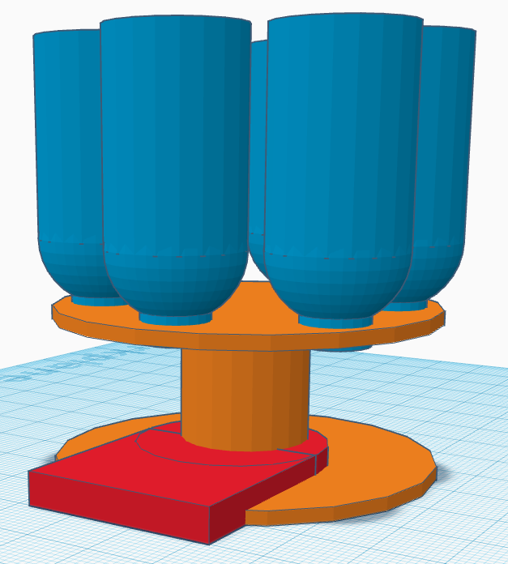
Proposed Design
Initial designed had a few issues
Top heavy, the weight of the electronics and ingredients would not be secure
Only a single flow sensor for all ingredients
No room for electronics
Solid ingredients don’t dispense well from a flow controller
Notes:
Cody

Slide 11
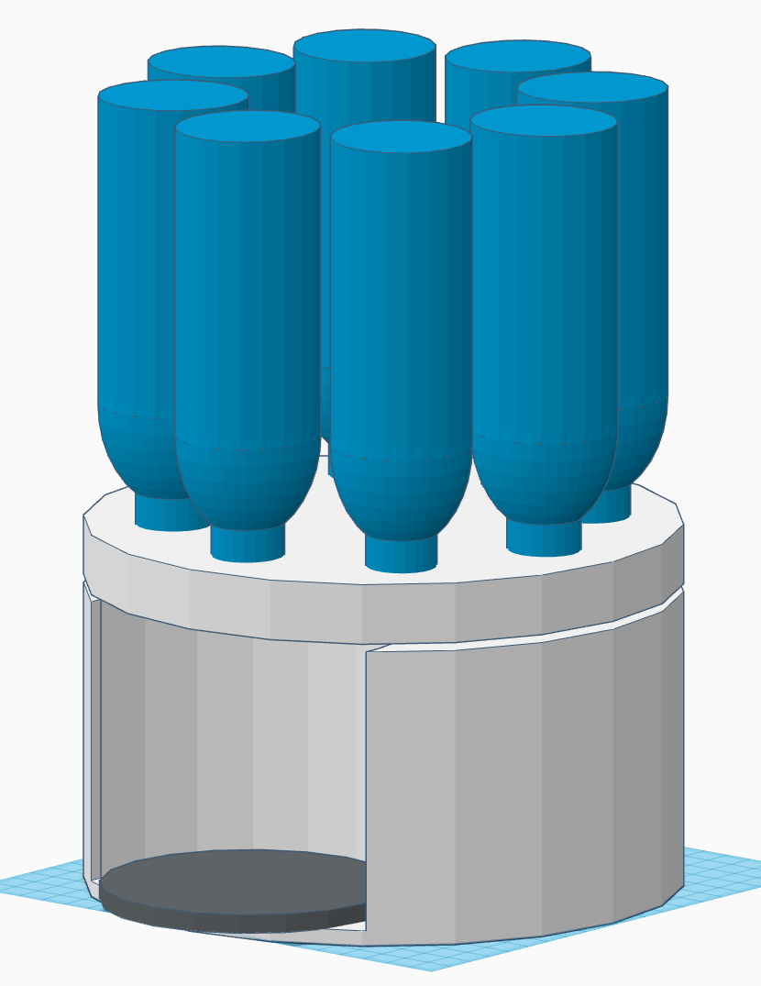
Design Updates
Updated design to alleviate these problems
Solid frame to support weight and hide electronics
Individual flow sensors for liquid ingredients
Solid ingredient dispensed with rotational force
Finalized Design will be 3D-printed
Notes:
Cody
Easier to use individual flow sensors rather than trying to use one flow sensor and switch ingredients
Also less messy and less cross contamination between ingredients
- Scoop / water wheel like design inside to move ingredients out in a relatively controlled manner
- Individual parts 3D-printed and prototyped before proceeding with the next parts

Slide 12
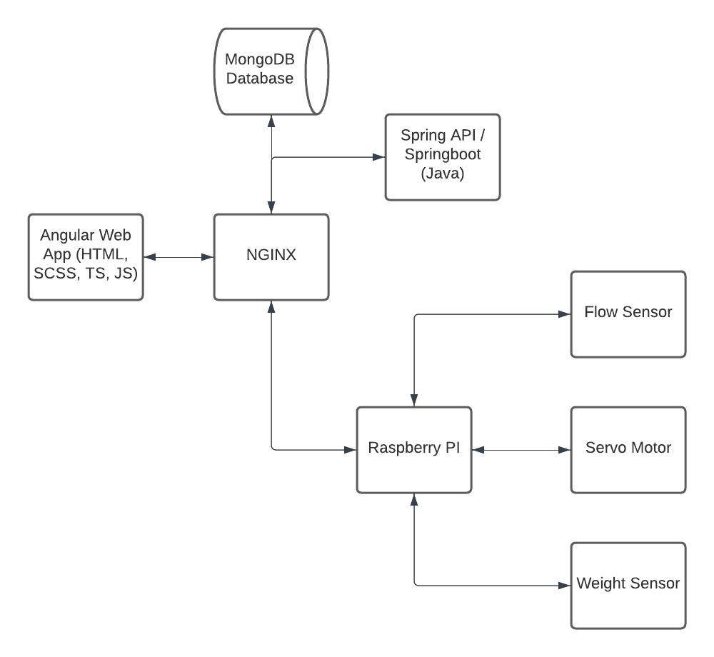
High-Level Design
Notes:
Zach

Slide 13
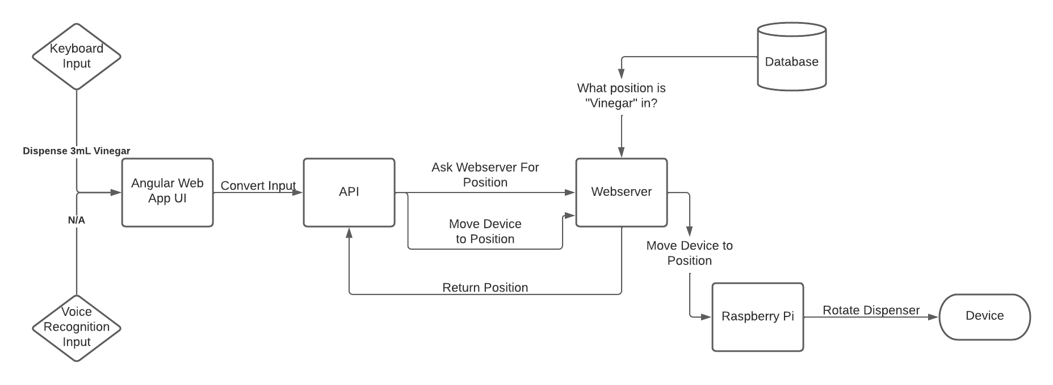
Notes:
zach

Slide 14
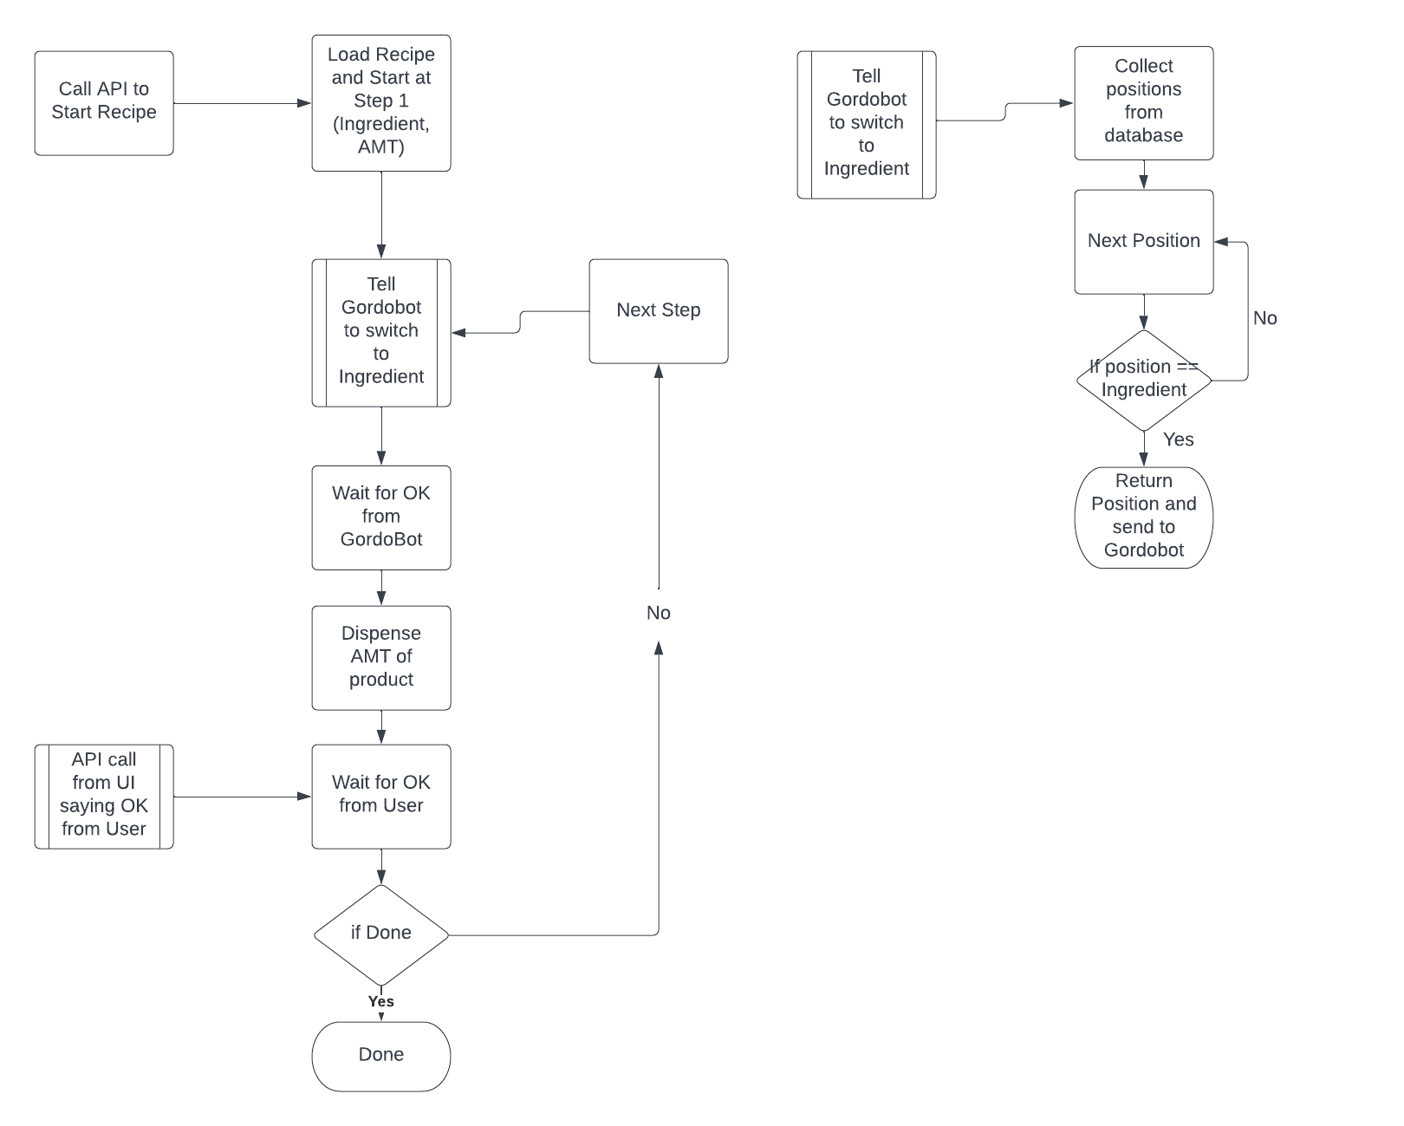
Information is stored in a JSON
Example API Design for One Recipe
Notes:
zach

Slide 15
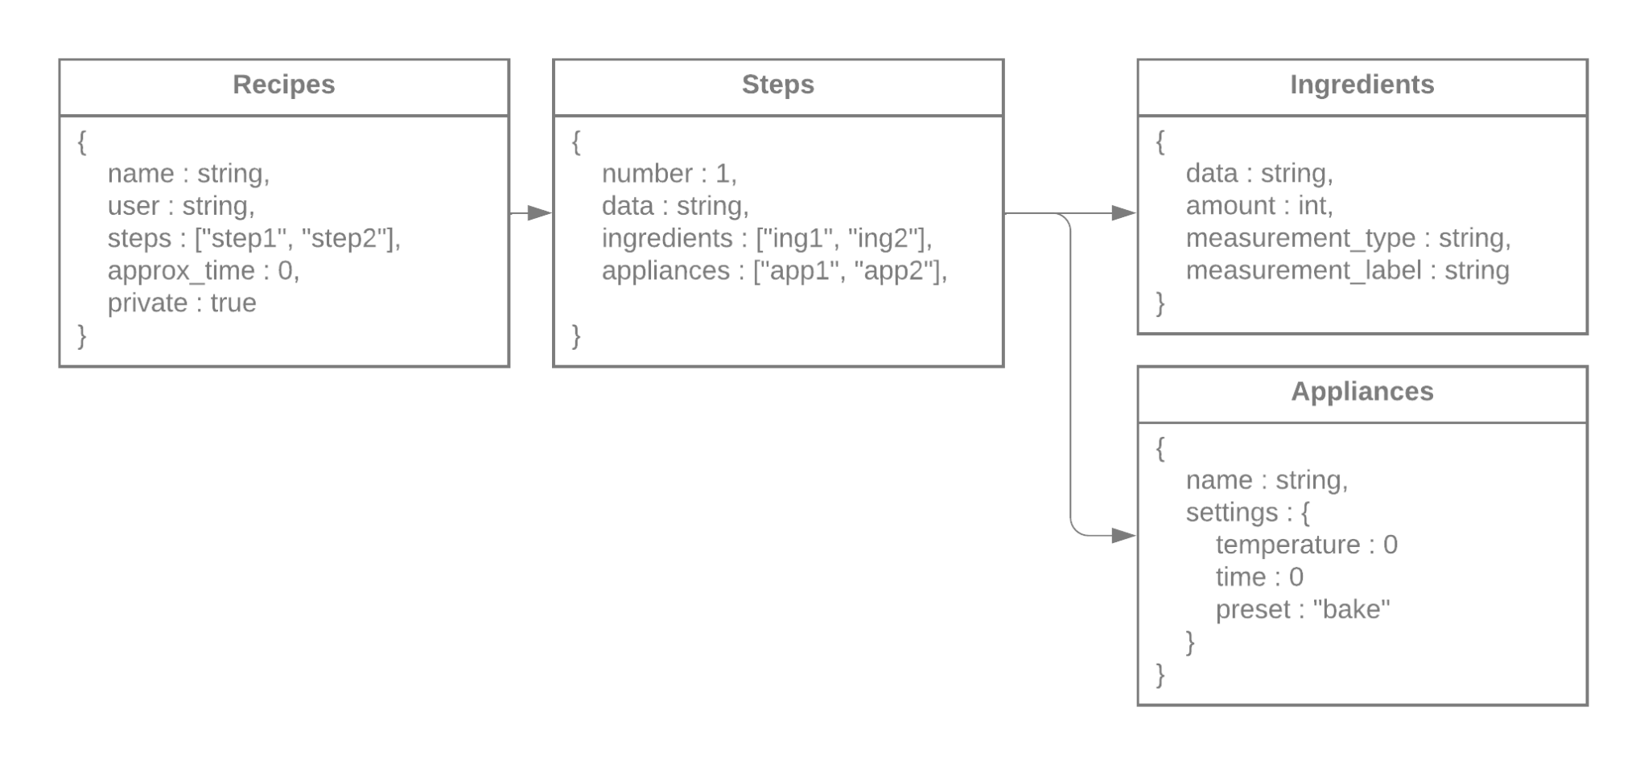
Design: Database Collection
Collections for the database
Json format (mongodb)
Break down recipe into simple steps
Break down ingredients into amount and type
Break down appliances into name and settings
Notes:
Jake

Slide 16
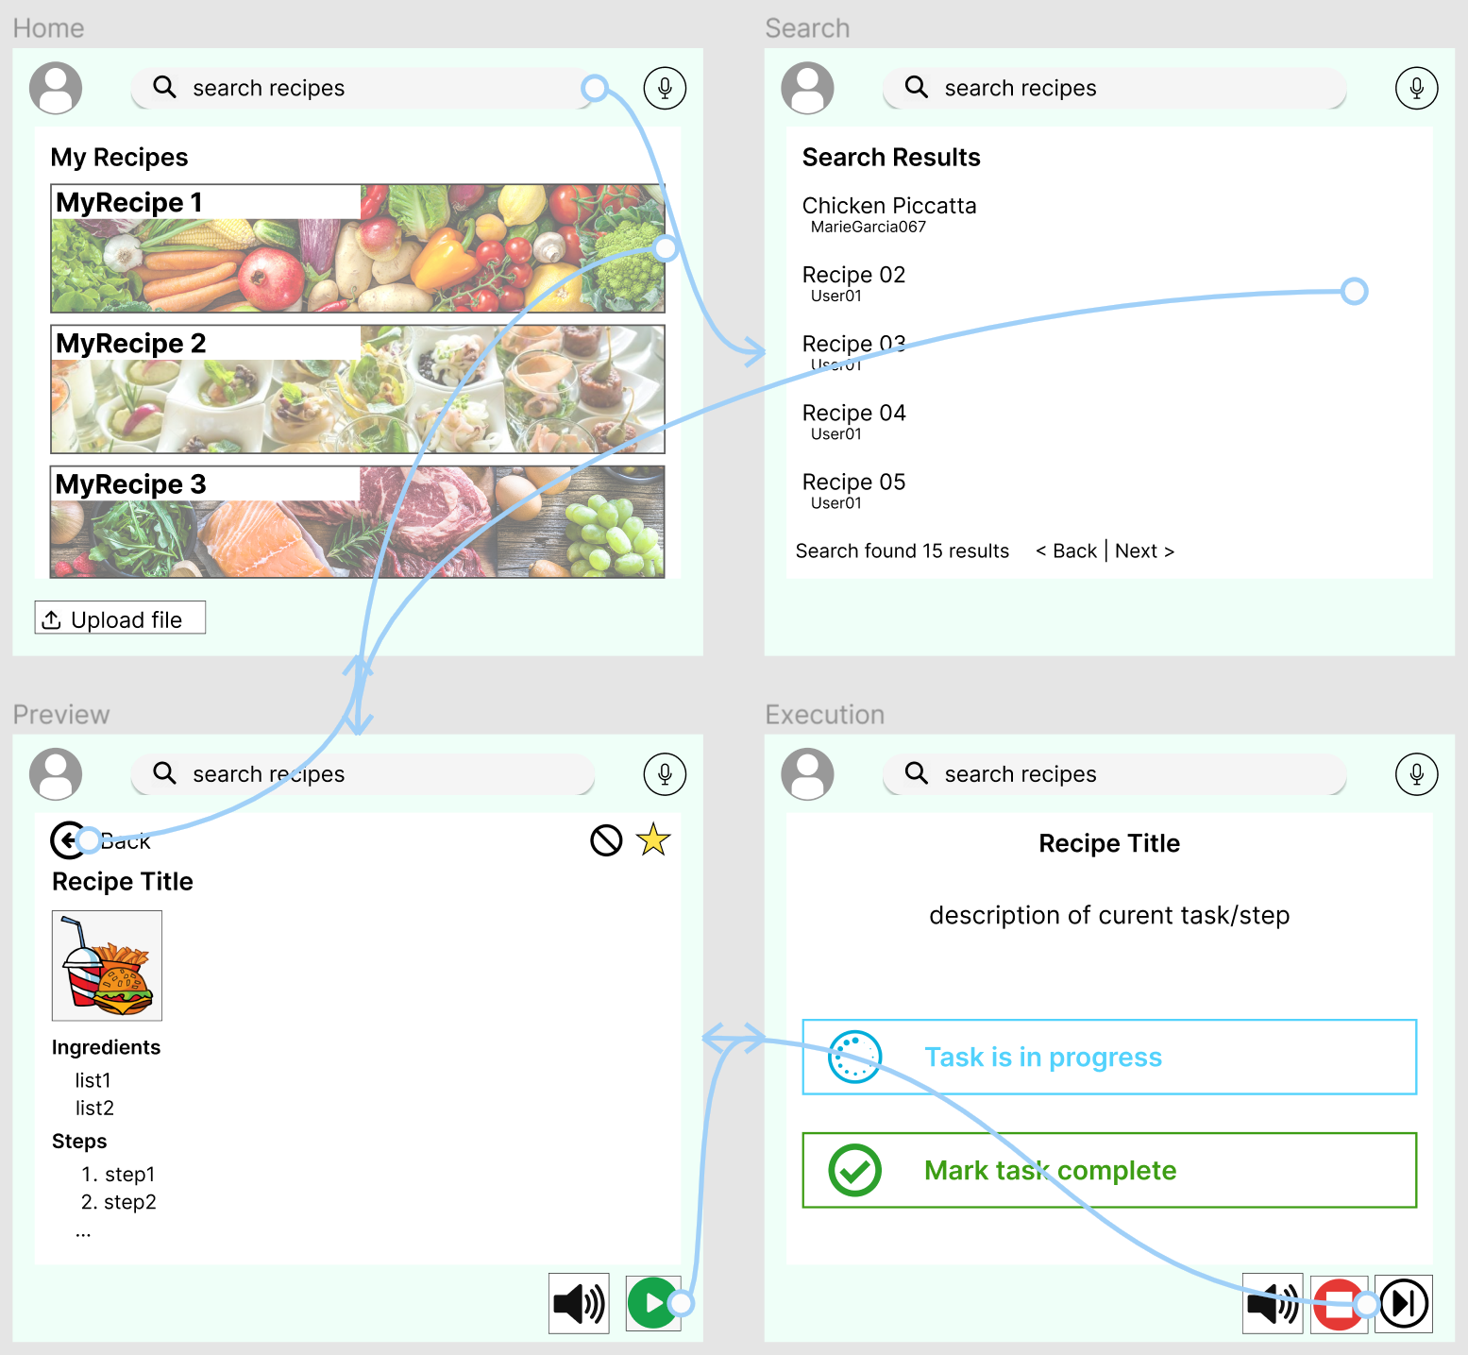
User Interface Design
To the right is the basic wireframe showing how the application interface is currently meant to work.
It is made to be easily adaptable if needed. Some functionality may later be added, modified, or subtracted.
Done via FIgma.
Notes:
Raney

Slide 17
Project Management
Notes:
Reid

Slide 18
Project Management: Division of Labor
Project management approach remains the same
Discord for communication
Jira for project management
Google Drive for documentation and file sharing
GitHub for code
The following are the assigned areas of responsibility in the project, but jobs will often overlap to support each other.
Reid: Software/Hardware Integration
Cody: Hardware and Sensors, Notetaker
Jake: Cloud Services and Communication
Raney & Nick: Interface Designers
Zach: API Design, Project Management
Notes:
Reid

Slide 19
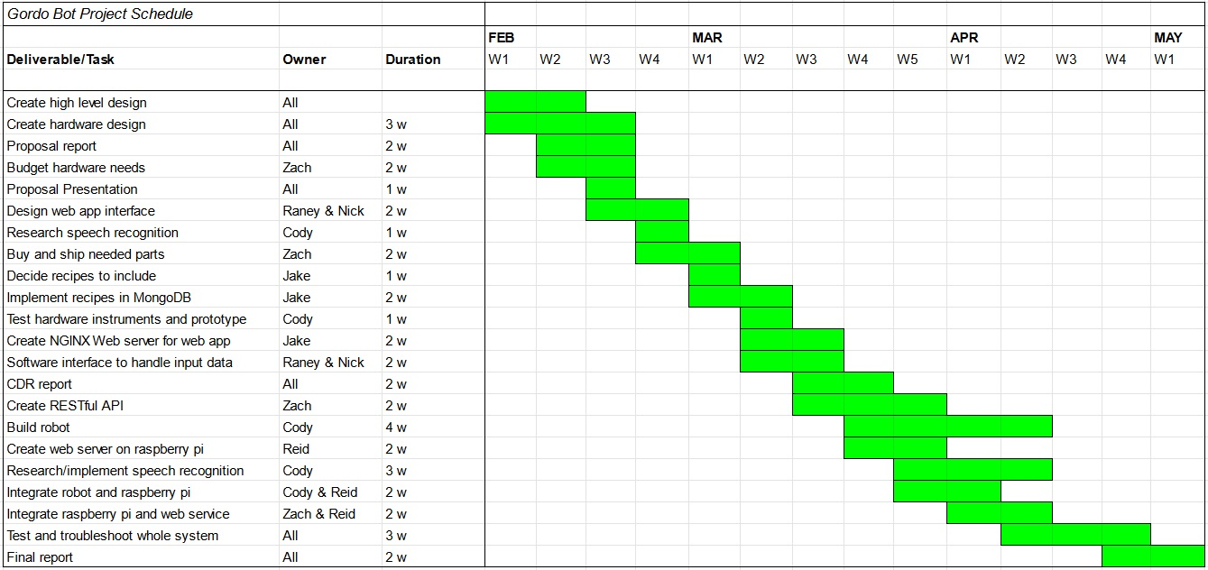
Project Management: Schedule of Tasks
Notes:
Reid

Slide 20
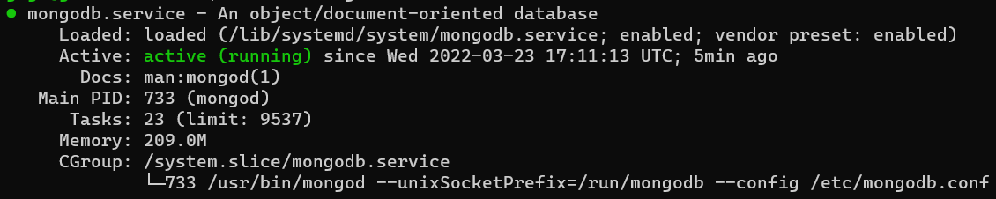
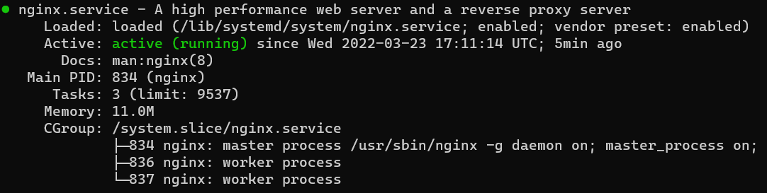
Preliminary Results
Web server and database set up
Notes:
Nick

Slide 21
Preliminary Results - continued
Web page progress
Servos, sensors, how they work
Prototyping (3D models)
Flask server running on Raspberry Pi with framework in place to give robot instructions
Notes:
Nick

Slide 22
Testing and Validation Procedures
Add basic recipes to send through system
Should parse title, description, image, ingredients, and steps as needed
Have several types of recipes in different formats
Add basic ingredients to test hardware
Water
Salt
Flour
Sugar
Vinegar
Test speeds are in line with requirements
Test accuracy with different types of measurement units
Test speed of communication with server is within bounds
Test smooth user experience with step-by-step implementation
Notes:
Nick

Slide 23
Questions, Comments, Concerns?

